Slide 1
Advanced Data Search
With Advanced Data Search you can create customized downloadable data sets of case and election information.
Check it out now!

Slide 2
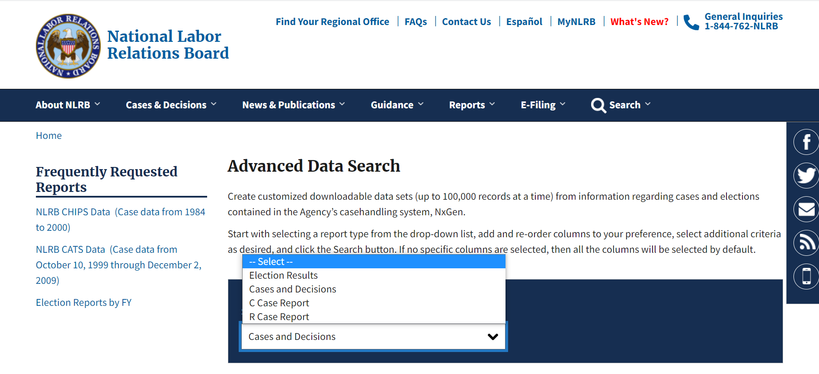
Advanced Data Search
Start with selecting a report type from the drop-down list.
Check it out now!

Slide 3
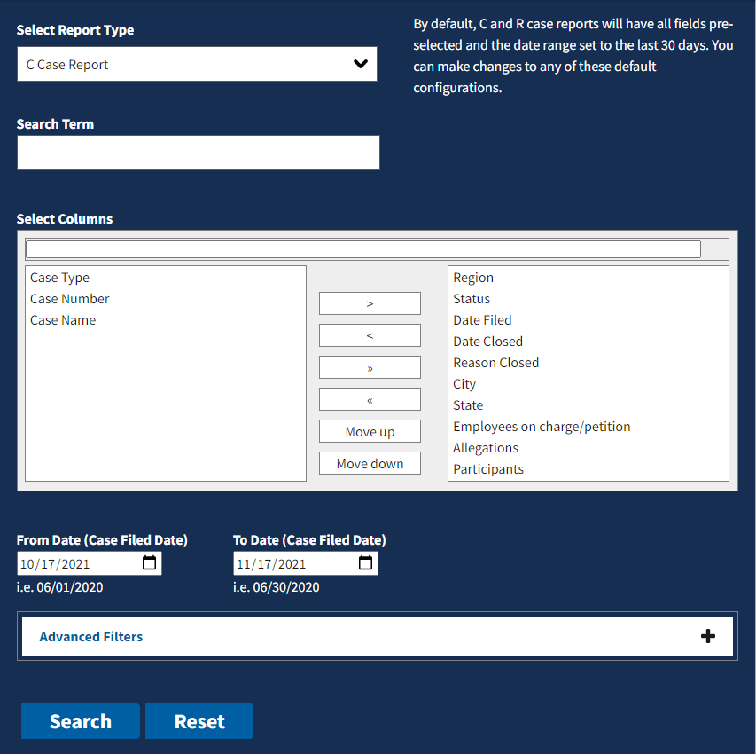
Advanced Data Search
You can add and re-order columns to your preference, select additional criteria as desired, and click the Search button.
If no specific columns are selected, then all the columns will be selected by default.
Check it out now!

Slide 4
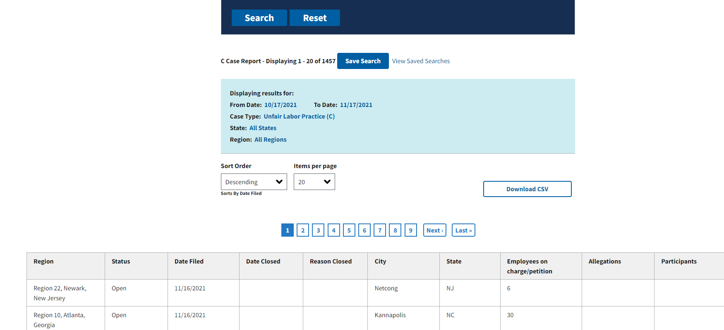
Advanced Data Search
After receiving your search results, you can download the CSV.
Check it out now!

Slide 5
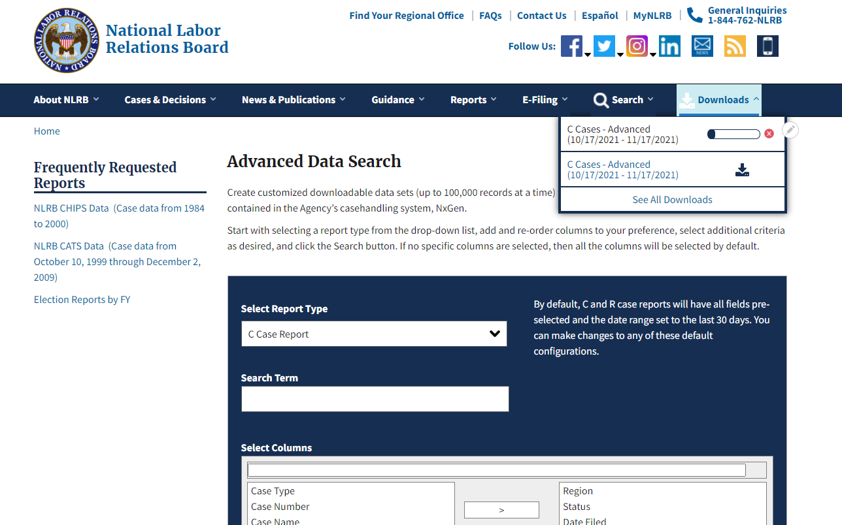
Advanced Data Search
If you are downloading a larger data set, it may take a few minutes. You can continue to use the site as your data set downloads in the download tray at the end of the menu bar.
Check it out now!

Slide 6
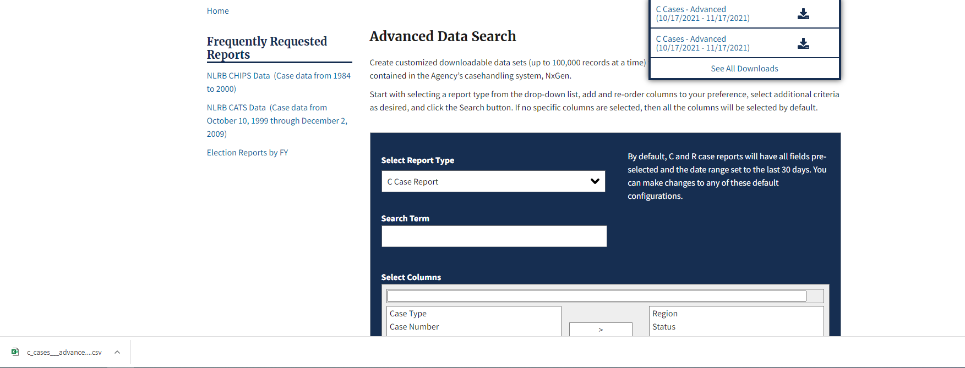
Advanced Data Search
Once the download is complete, your file will load on your browser and be ready for you to view.
Check it out now!

Slide 7
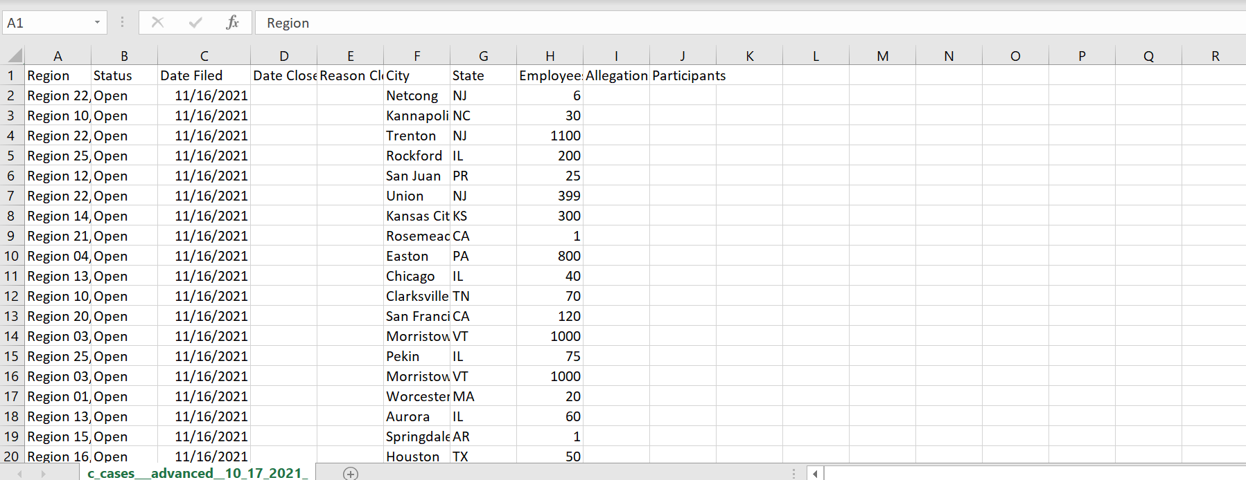
Advanced Data Search
Create and download your own customized data set today!
Check it out now!

